Slide 1

Filament micro- Gripper ​CDR
​Customer: Shai
20.08.2022​
YICHENG WANG 941190910 ZHIYUAN LI 941190894 JIYANG LIU 941180408

Slide 2
Introduction
With the rise of flexible production lines and advanced service robots, multifunctional grippers are becoming a more popular choice among manufacturers than traditional grippers. Conventional industrial grippers with two sets of pin arrays cannot hold certain objects, which requires more versatile and adaptable end effectors capable of gripping objects of various geometries.
We needed a versatile gripper that could grab a wide variety of objects of different shapes, weights and materials. Considering the disadvantage that the use of soft materials will greatly shorten its service life, we will focus on designing rigid universal clamps.

Slide 3
Introduction
This concept features a strong gripping force through relative linear motion between the two bases. The first base is connected to a linear actuator, which facilitates smooth linear motion, while the second base is fixed in space and connected to the first base by two linear guides on each side.
A major advantage of this design is that only a small displacement of the base can produce an effect comparable to that of a parallel clamp, which can be much larger in size. However, this design prefers a specific grasping orientation when the target object is slender. More specifically, the moving direction of the first base is preferably perpendicular to the side of the object with a longer characteristic length.

Slide 4
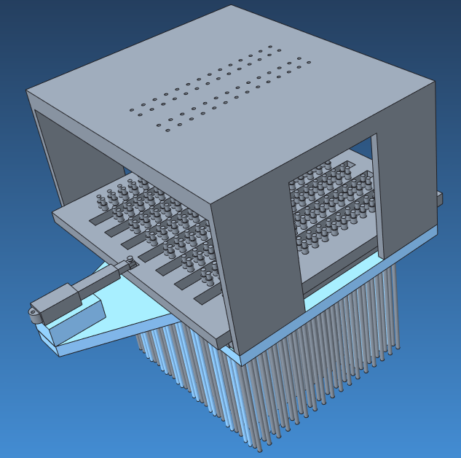
Isometric View of the Design

Slide 5
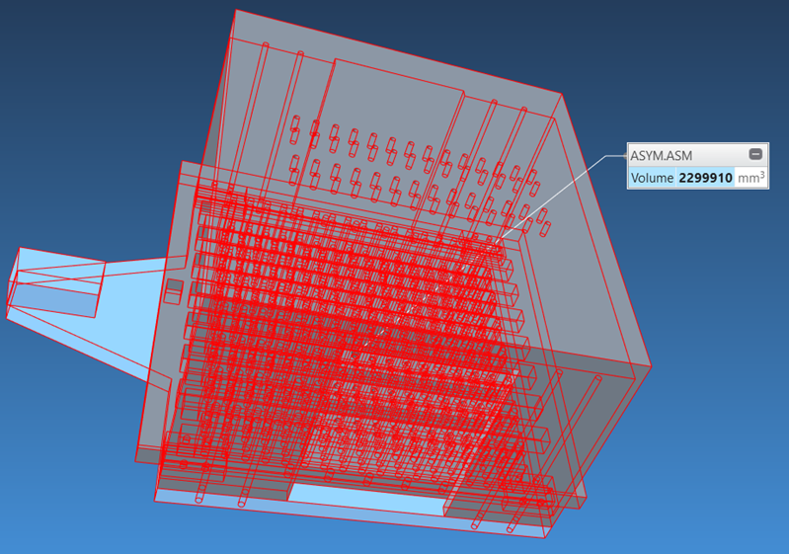
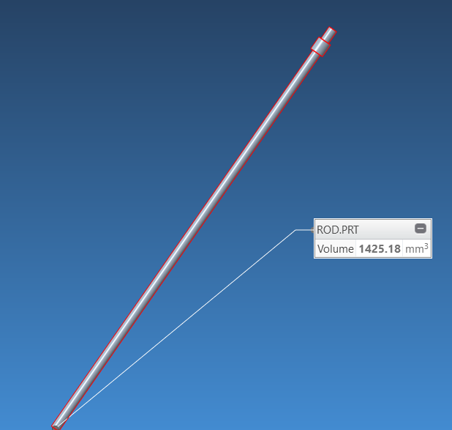
Bill of the material
Production with PLA which is compatible with 3D printing. The average price for a 1kg PLA is about 20.00$. Considering the different filling level of different part, the gross material cost is 30.30$ approximately

Slide 6
Table of components and properties
Part | Size | Numbers
Lower base | L=284mm ;W=237mm H = 10mm | 1
Cap | L=237mm ;W=200mm H = 110mm | 1
Upper base | L=225mm ;W=225mm H = 30mm | 1
Pin array 1 | D=2.5mm; L=172.2mm | 272
Pin array 2 | D=2.5mm ;L=152.7 mm | 238
Linear actuator | 10mm stroke | 1
Force Sensing Resistor | D=3.8mm (active area) | 1
Linear rail | L=20mm | 1

Slide 7
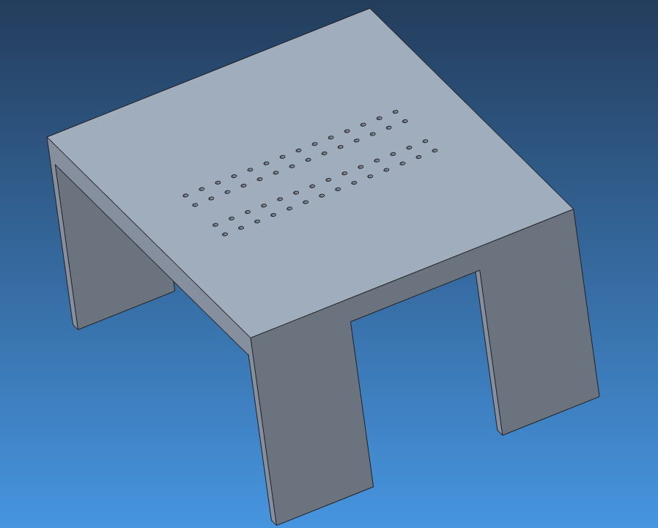
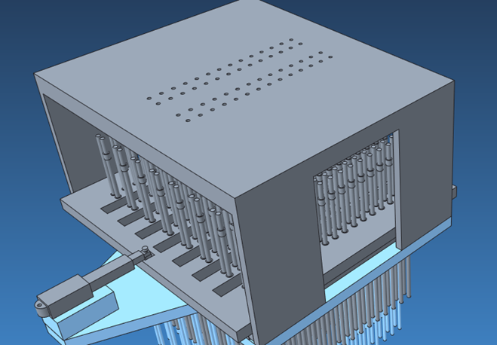
Independent section for each mechanism
Gripper end (Cap)
The screw holes distribution is designed to match with that of the gripper end from a real robotics arm in Technion.
Besides serving as an important connection, the cap also leaves enough room for the contraction of the pin arrays due to external forces

Slide 8
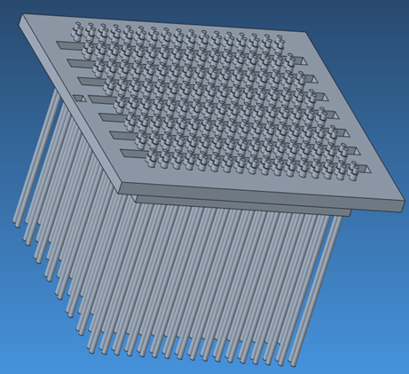
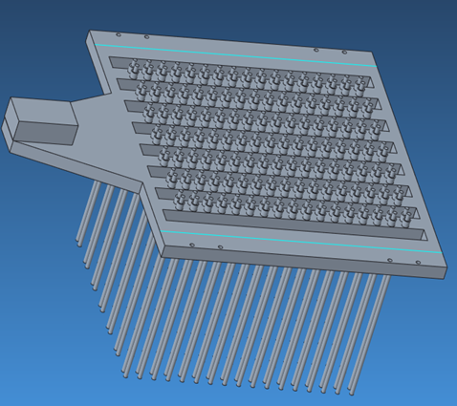
Independent section for each mechanism
Upper and Lower Base
The structure of the upper and lower are closely resembled.
The main difference is that the upper base is connected to a linear actuator, and it will slide on the linear rail installed to the lower base (blue line) when the actuator is initiated, while for the other base, it’s stationary relative to the target object, and external components such as linear rail and linear actuator are mounted on it.

Slide 9
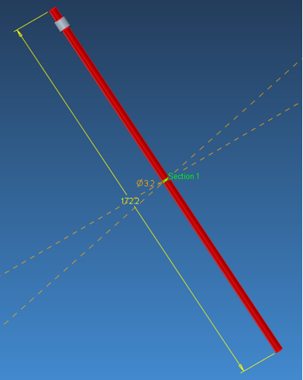
Independent section for each mechanism
Pin Array
The structure of a single pin is a slender cylinder with a head at the position near its tip to prevent the pin from falling due to gravity.
Its upward motion is also constrained by the cap introduced before. There’re two types of pins, and the only discrepancy is their length.

Slide 10
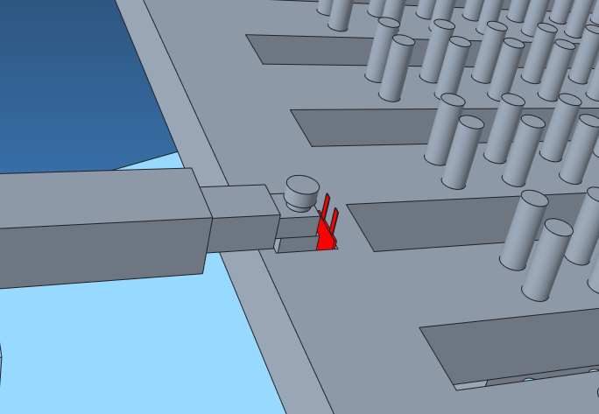
Independent section for each mechanism
Force sensor resistor and linear actuator
Mechanism to obtain the appropriate final position of the gripper
A force sensor resistor (FSR) is attached in a designed groove as illustrated below. The groove is slightly wider than the actuator end so that the FCR can be properly placed. When the actuator end moves forwards and becomes in contact with the FSR, the sensor will feel the pressure and changes its internal resistance accordingly,

Slide 11
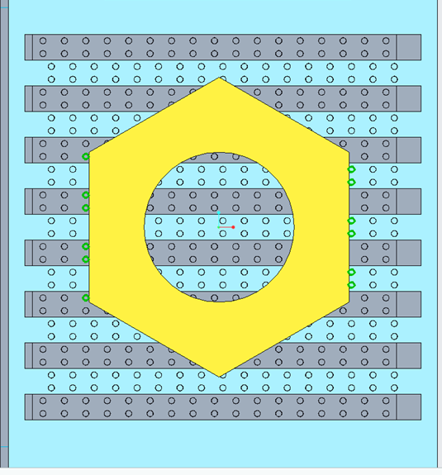
Analysis for Nuts grasping
For a nut-shaped object, one possible gripping mode is demonstrated right. Twelve pins will have direct contact with the outer surface of the object after it is clamped. Six of them provide force pointing to the left, while the other six provide force in the opposite direction. Under such circumstance, we assume each pin on the same side will exert an equal normal force, and thus equivalent friction across the surface.

Slide 12
Analysis for Nuts grasping
Assume the object is made of plastic with a density of 1.25[g/cm3], and its volume is 444.106[cm3], thus its mass is 5.44 N. approximately. We also assume the friction coefficient between rubber and plastic is roughly 0.7. Therefore, required normal force to lift the object is 7.77N, and the force distributed on each pin is 0.657N.

Slide 13
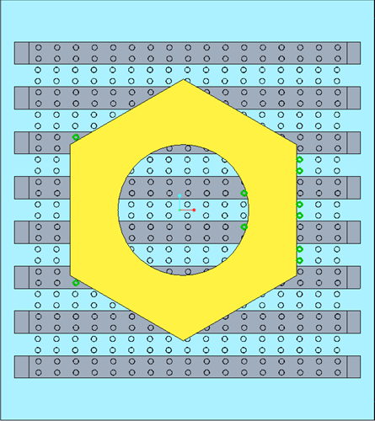
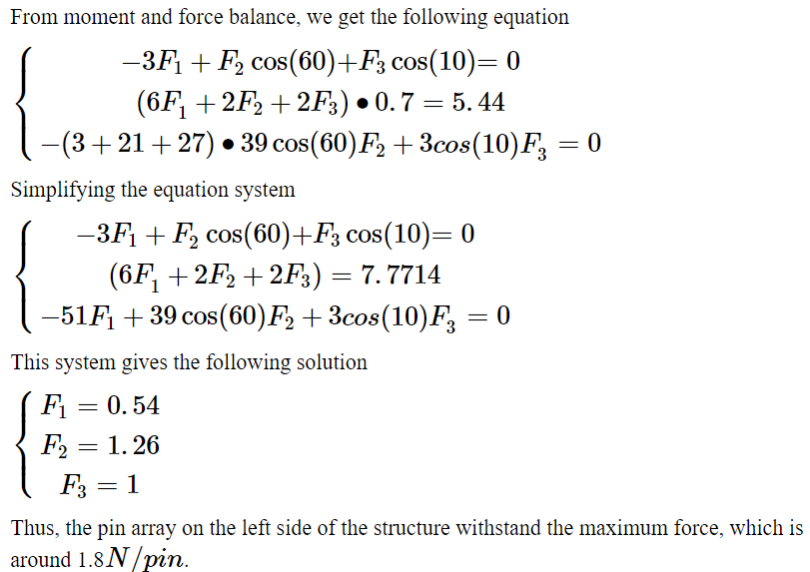
Another possible gripping state

Slide 14
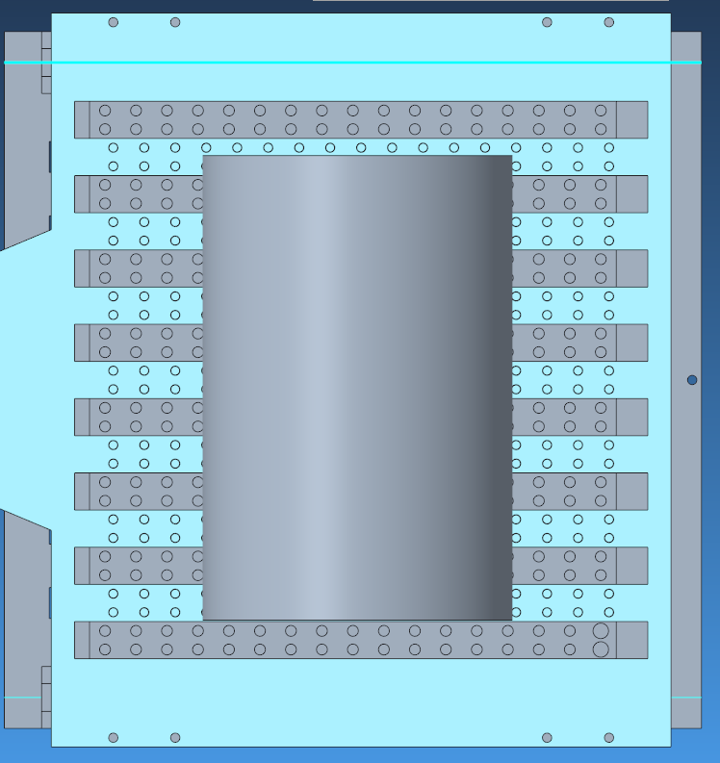
Cylinder grasping
We make the same assumptions as before. The cylinder is made of plastic with a density of 1.25[g/cm3]. The diameter of the cylinder is 10cm, and the height of the cylinder is 15[cm]. Therefore, the volume of the cube is V=1767.1[cm3], and the mass is 21.7[N] approximately. We also assume the friction coefficient between rubber and plastic is 0.7. Therefore, the required normal force to lift the object is 30.9[N]. In this case there are 25 rods in contact with the cylinder, then the force distributed on each pin is 1.29[N].

Slide 15
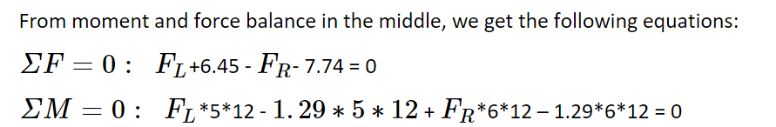
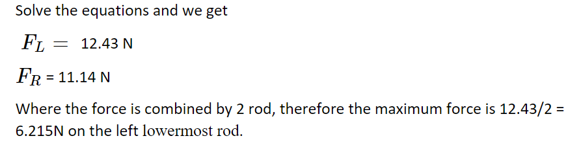

Slide 16
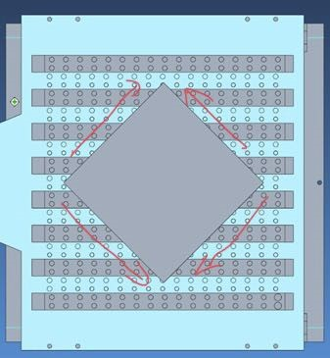
Cube grasping
For a cube, one possible grab is a grab at a 45-degree angle as shown. The length of the cube is 100[mm]. The cube is made of plastic with a density of 1.25 [g/cm3]. Therefore, the volume of the cube is V=1000[cm3], and the mass is 12.26[N] approximately. The friction coefficient between rubber and plastic is 0.7. Therefore, the required normal force to lift the object is 8.58[N]. In this case there are 16 rods in contact with the cylinder, then the force distributed on each pin is 0.54[N]. We can decompose the whole force into normal and shear force. From the picture we can see that the corner of the square will stand the biggest force. The rod on the corner will provide 0.54/(√2/2)= 0.76[N] force.

Slide 17
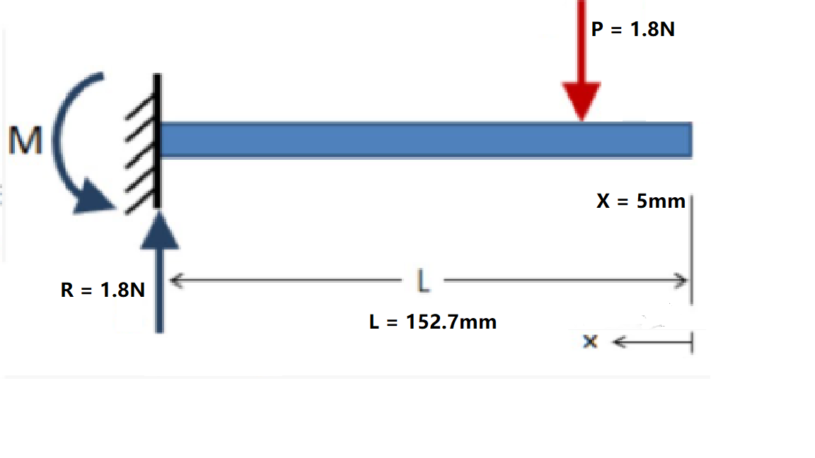
Bending analysis
In this section we are going to analysis the bending filament.
From PDR our grasping object is a nut. It is the thick part of the bottom of the filament that is in contact with the object in the horizontal direction, and the height is 10mm. Therefore the force on filament is at x=5mm. The total length of filament is L=152.7mm. And we calculated the maximum force on filament is F=1.8N.

Slide 18
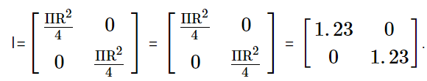
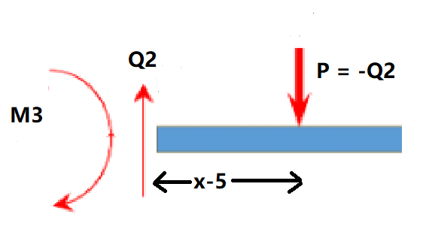
First, we calculate the moment of inertia for one filament.
For circular section,
The young modulus is E=4.107Gpa.
EI = 5.052*10^(6)
Then we do the beam break analysis:
For x∈(0,5) there is no force and moment on beam. Then the beam keeps rigid.
For x∈(5,152.7):
ΣMe3 = -M3+P*(x-5) = 0
M3 = P*(x-5) = M(x)

Slide 19

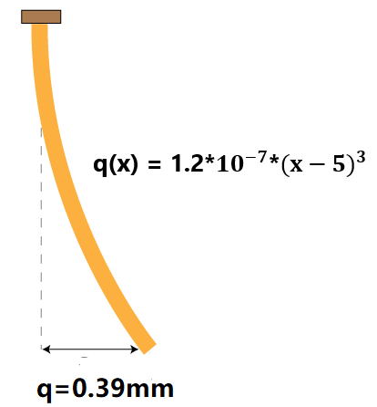
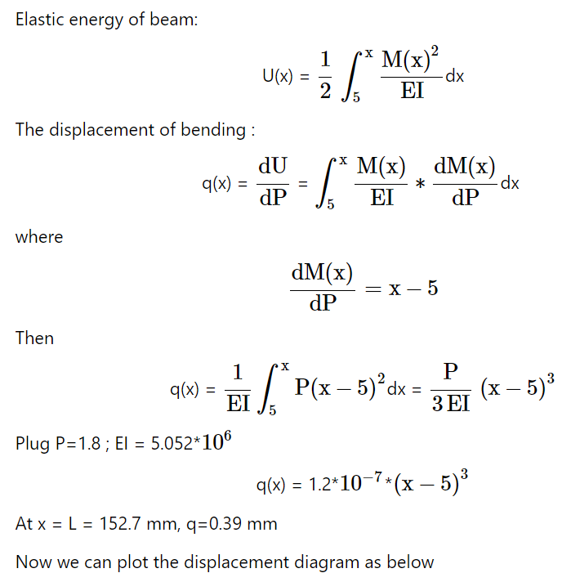



Slide 20
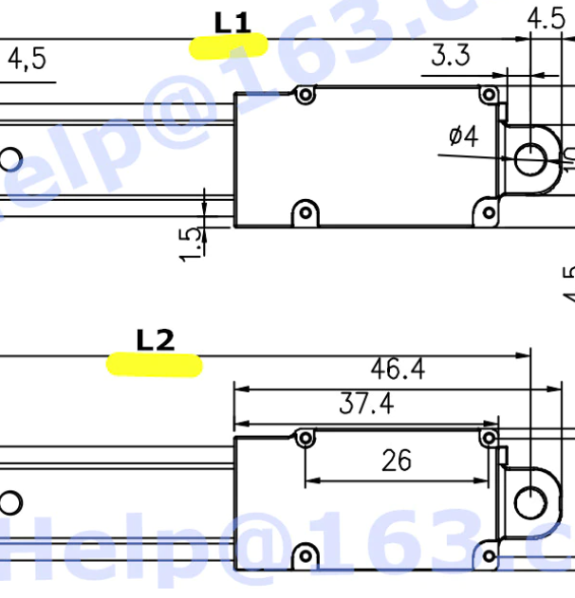
Reference
Linear actuator: we’ll choose a 10mm stroke linear actuator, with a fully close length(L1) equal to 64.4mm, and a fully open length(L2) equal to 74.5mm. Shown below is the schematic drawing of the actuator.
The link to the website where such an actuator is provided is as follows
https://www.aliexpress.com/item/1005001427208855.html?spm=a2g0o.productlist.0.0.49b21ec0usVdrX&algo_pvid=d737ee82-11e8-4ada-a656-c4dabeca4daa&aem_p4p_detail=2022072603084212301535322487740066432051&algo_exp_id=d737ee82-11e8-4ada-a656-c4dabeca4daa-0&pdp_ext_f=%7B%22sku_id%22%3A%2212000016079927411%22%7D&pdp_npi=2%40dis%21ILS%21%2175.76%21%21%21%21%21%402100bddf16588301226804257e823f%2112000016079927411%21sea

Slide 21
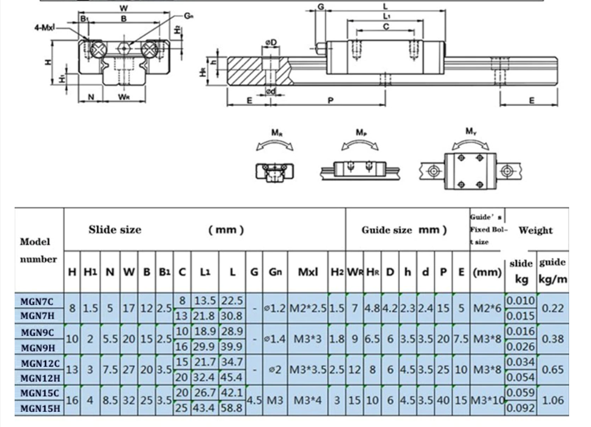
Reference
Linear Rail : We reckon MGN9C model as the suitable model since it’s neither too large to occupy the area for pin arrays, nor too small to support the motion of the upper base. The rail length is chosen as 200mm to cover the whole range of the base.
The link to the website where the rail is provided is as follows
https://www.aliexpress.com/item/4000706013922.html?spm=a2g0o.order_detail.0.0.1981f19cb0tYrZ

Slide 22
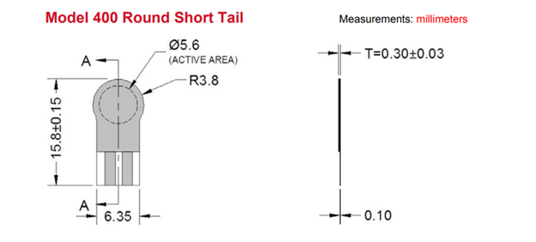
Reference
Force sensor resistor: We’ll select model 400 short tail FSR, shown below is the dimensional description of this type
Full specification of the sensor is available from the link below
https://www.pololu.com/file/0J749/FSR400-Series-Integration-Guide-13.pdf

Slide 23
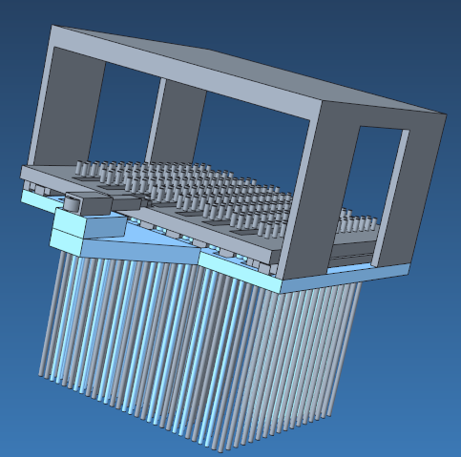
Production file

Slide 24
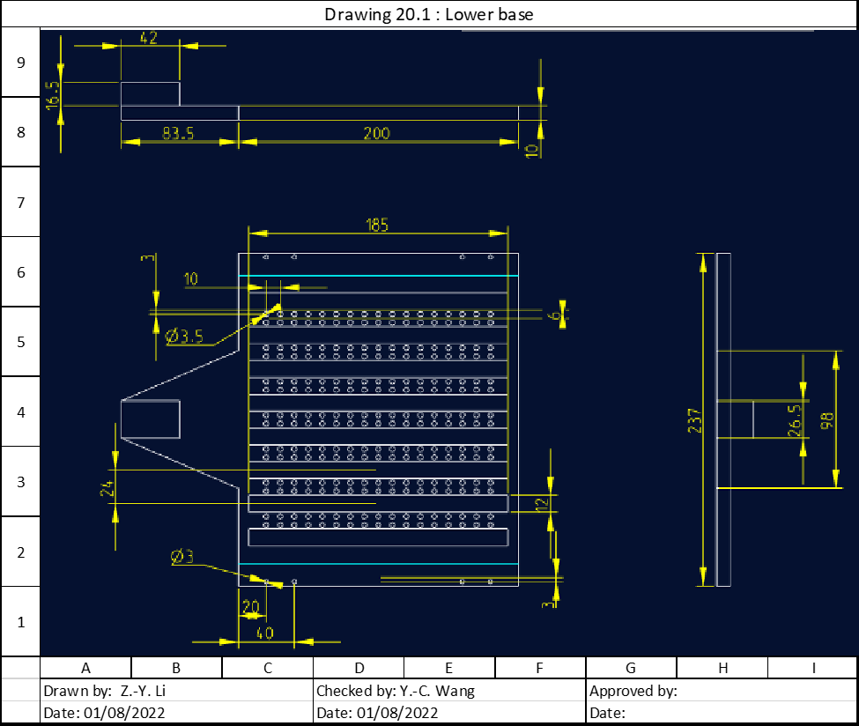

Slide 25
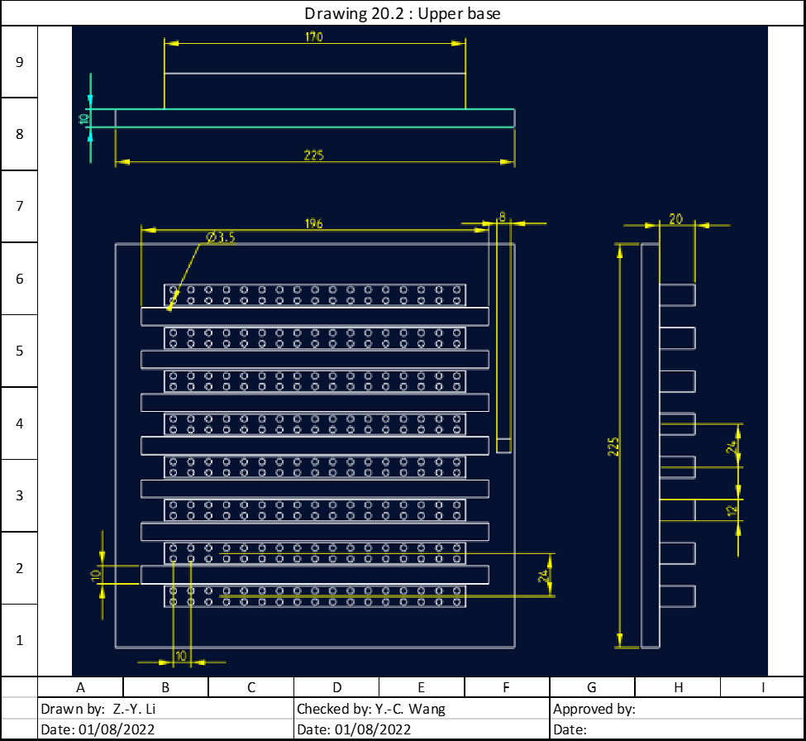

Slide 26
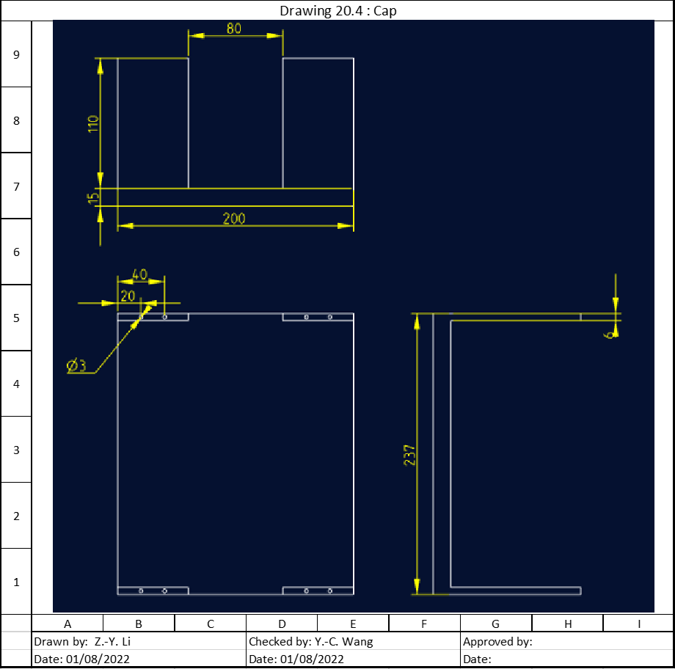
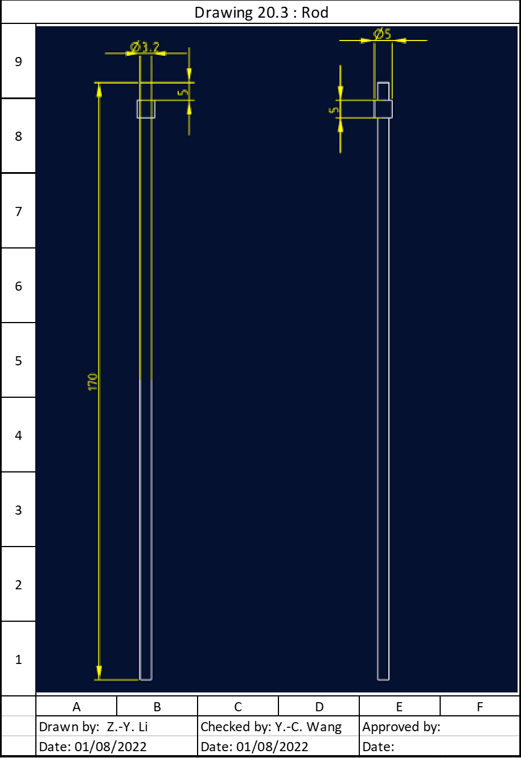

Slide 27
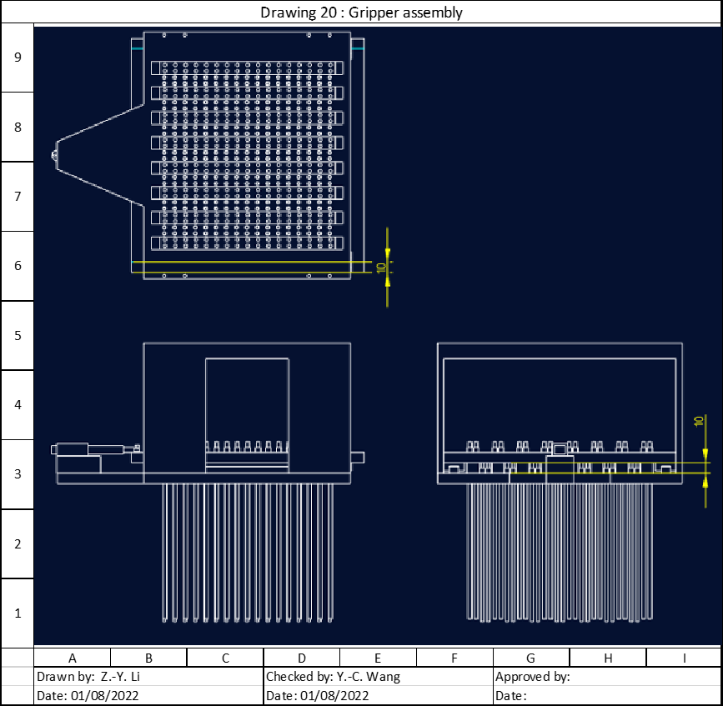

Slide 28

Thank you so much

